Slide 1
IoT-Based Drinking Water Quality Monitoring System
Batch 13
MOHAMMED SHAFEEHE
SARANG T MAHESH
NIRANJAN S PRASAD
JASIR NUFAIZ
GUIDE
PROF. LASEENA C

Slide 2
Introduction
The IoT-based Drinking Water Quality Monitoring System with ESP32 is a project aimed at addressing the critical need for ensuring access to safe and clean drinking water.
With the rise in water pollution and contamination issues globally, there is a growing demand for efficient monitoring systems that can provide real-time data on water quality.
This project leverages the power of IoT technology and the versatility of the ESP32 microcontroller to create a cost-effective and scalable solution for monitoring the quality of drinking water remotely.

Slide 3
OBJECTIVES
Real-time water quality monitoring.
IoT-enabled remote data transmission.
Sensor-based parameter measurement.
Cost-effective ESP32 solution.
Seamless sensor-ESP32 communication.
Internet-based data visualization.
Promote water quality awareness.

Slide 4
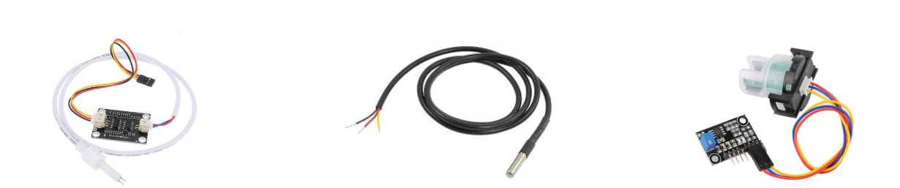
COMPONENT SPECIFICATION
The system typically includes :
1. Sensors:
> Analog Total Dissolved Solid Meter: Measure Total Dissolved Solids in water by detecting
changes in electrical conductivity.
> Temperature Sensor(DS18B20): Digital temperature sensor with high accuracy.
> Turbidity Sensor: Detect suspended particles in liquids by measuring light scattering.

Slide 5
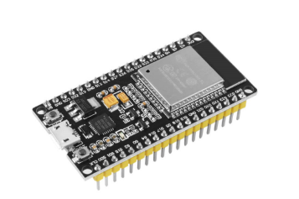
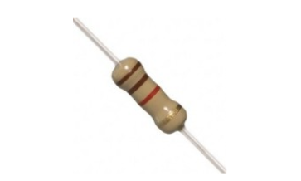
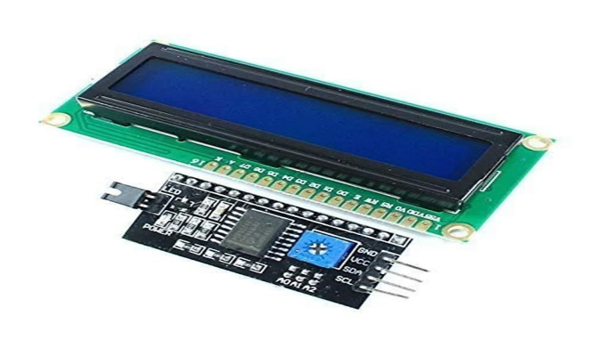
Esp 32 : The ESP32 is a multifunctional microcontroller renowned for its integrated Wi-Fi and Bluetooth capabilities, facilitating IoT development.
LCD Display : Flat panel display which uses liquid crystals in its primary form of operation
Resistor : A passive electronic component that restrict the flow of electric current.

Slide 6


Block Diagram
ESP 32
LCD display
Temperature
TDS
Turbidity
Data visualisation
Power supply

Slide 7
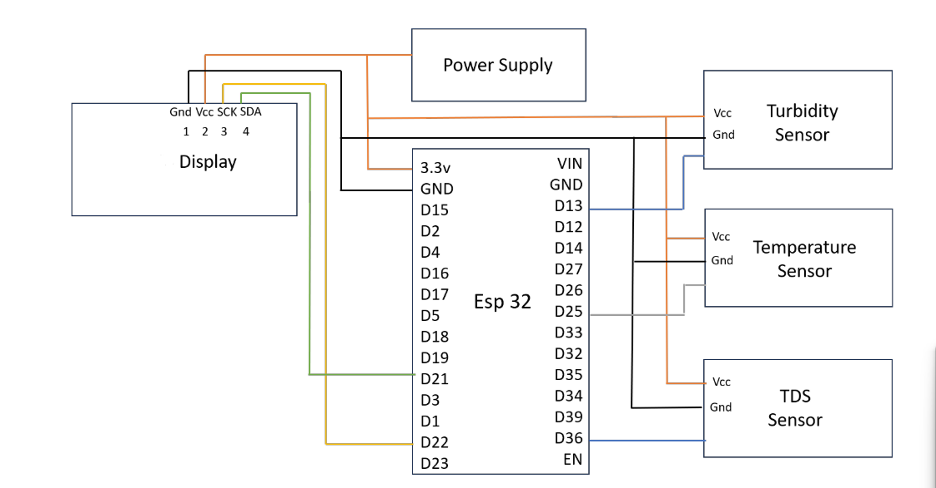
CIRCUIT DIAGRAM
LCD

Slide 8
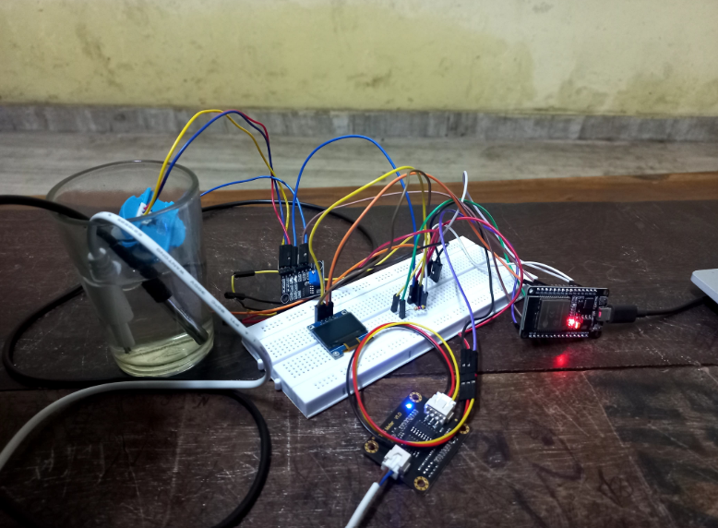
HARDWARE MODEL

Slide 9
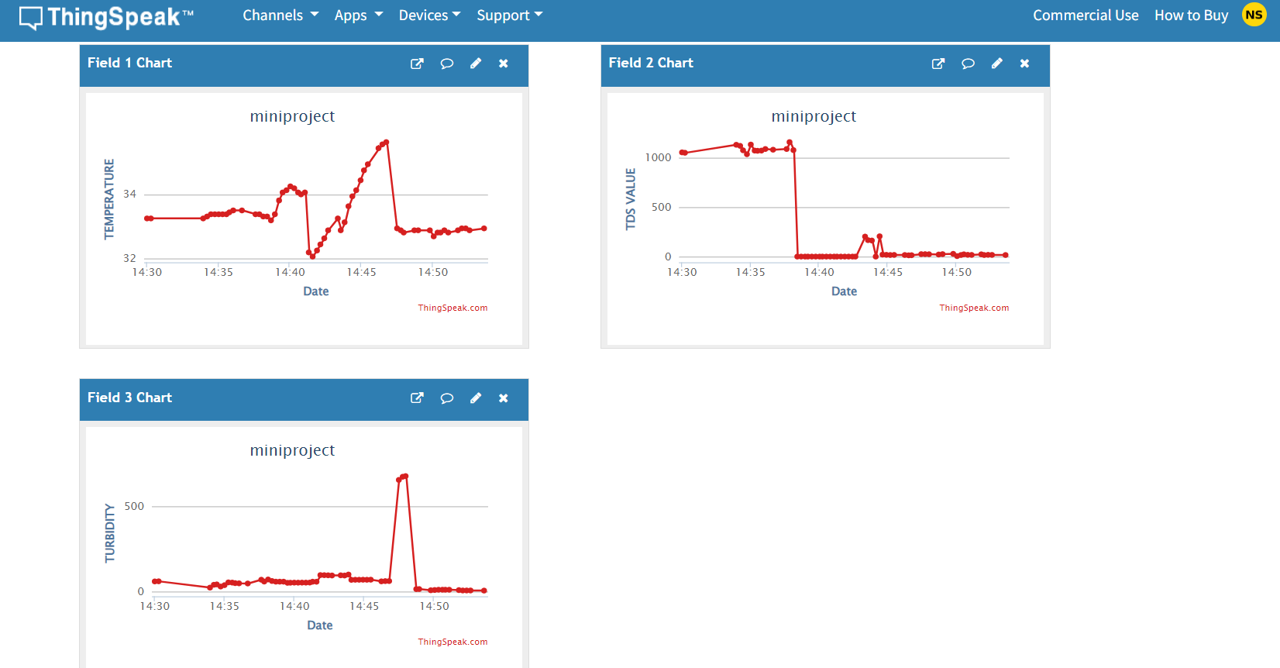
RESULT

Slide 10
RESULT ANALYSIS
WHO sets guidelines and standards for various aspects of water quality, including Temperature, Total Dissolved Solids (TDS) and Turbidity:
TDS levels below 150 mg/L are considered acceptable for drinking water, with lower levels preferred for better taste and palatability.
Turbidity levels below 5 nephelometric turbidity units (NTU) are considered acceptable for drinking water, with even lower levels preferred for optimal clarity.
Temperatures are typically kept within a comfortable range for consumption of drinking water, usually between 10°C to 20°C (50°F to 68°F).

Slide 11
CONCLUSION
Monitors TDS, temperature, and turbidity for safe drinking water.
Improves environmental health by monitoring water quality.
Uses microcontroller and sensors for accurate data transmission.
Scales from homes to larger networks for public health safety.
Automated, cost-effective monitoring without human supervision.

Slide 12
REFERENCE
https://how2electronics.com/iot-based-drinking-water-quality-monitoring-with-esp32/
Nikhil Kedia, Water Quality Monitoring for Rural Areas- A Sensor Cloud Based Economical Project, in 1st International Conference on Next Generation Computing Technologies (NGCT-2015) Dehradun, India, 4-5 September 2015.©2015 IEEE
Jayti Bhatt, Jignesh Patoliya, Iot Based Water Quality Monitoring System, IRFIC, 21feb,2016.
"Internet of Things (IoT) Based Water Quality Monitoring System". https://www.researchgate.net/publication/344167317_Internet_of_Things_IoT_Based_Water_Quality_Monitoring_System
World Health Organization, WHO/UNICEF Joint Water Supply, and Sanitation Monitoring Programme. Progress on sanitation and drinking water. World Health Organization, 2015.
WHO, Guidelines for Drinking-Water Quality. 4th ed.; World Health Organisation: Geneva, Switzerland, 2012.

